Slide 1


Mehr Chand Polytechnic College
Computer Science & Engineering
Industrial Training Viva
Anti Corruption App
Presented By
Name : Japnoor Singh
Roll No : 527/20
Date:
13 Sep, 2022

Slide 2

Index
Drawback of Existing System
Project Explanation
Modules
Advantages of Project
DFDs
Technology Used
Requirements
Screenshots
Conclusion
Future Scope
Thank you

Slide 3
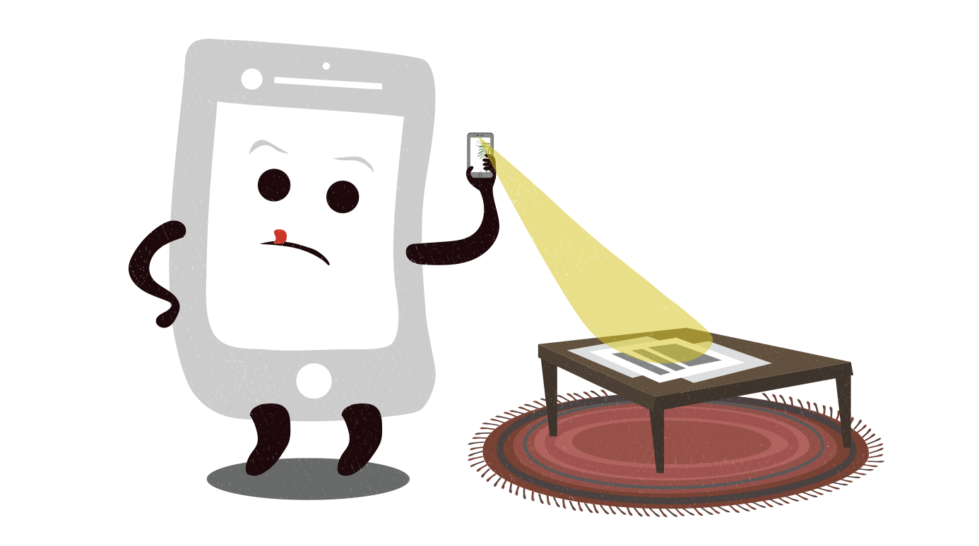
Drawback of Existing System
In the existing time, the society’s complaints are not taken seriously by the government. Hence, the rights of a common man are violated.
Although many laws are made to safeguard these rights, but there is no strict action taken against when there is violation of rules set by the government on a small scale.
There is no such system which keeps the record of such violations which leads to increase in bribery and corruption on a daily basis .

Slide 4

Project Explanation
This Android Application aims at providing facility of registering a complaint by recording audio or video of the officer asking or taking bribe.
Without using the Helpline number provided by the CM , this android application would let residents inform CM personally, about the officer.
The person who has to file a complaint will act as a user and while one handling the complaints will act as an Admin.

Slide 5
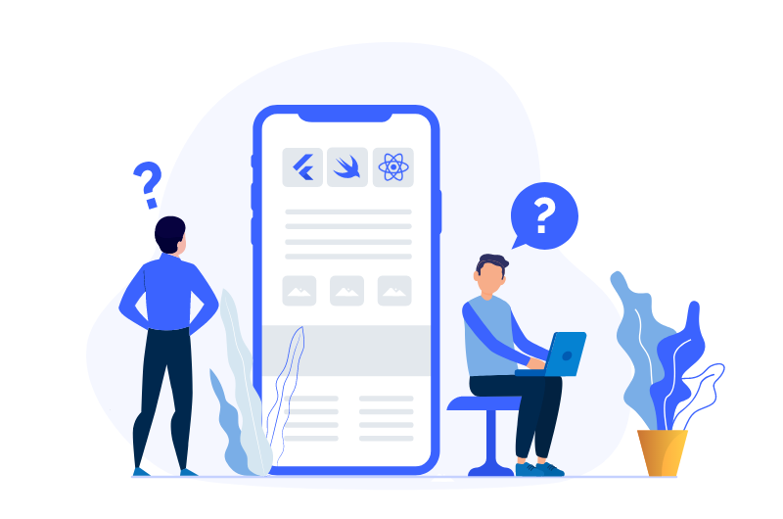
Modules
Admin Panel
User Panel

Slide 6

Advantages
This app will help in maintaining a proper record of all the complaints filed in future, which were filed on a WhatsApp helpline number.
The user will be able to see the status of their complaint whether it is rejected or accepted.

Slide 7
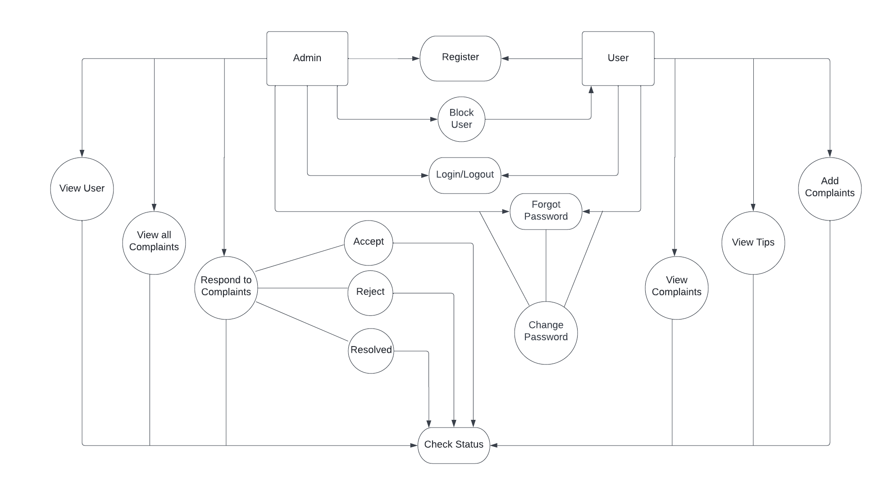
Data Flow Diagram of Project

Slide 8
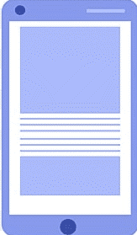
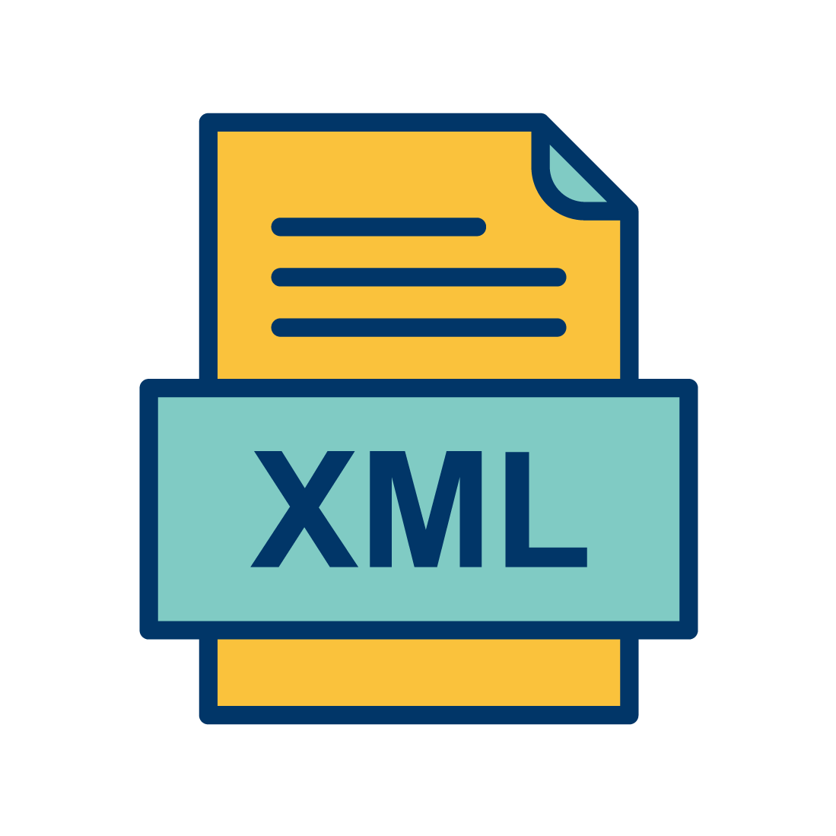
Front End Technology
XML
XML stands for Extensible Markup Language.
In Android, the XML is used to implement UI-related data, and it’s a lightweight markup language that doesn’t make layout heavy.
XML only contains tags, while implementing they need to be just invoked.
<Xml.....>
.
.
</Xml>

Slide 9
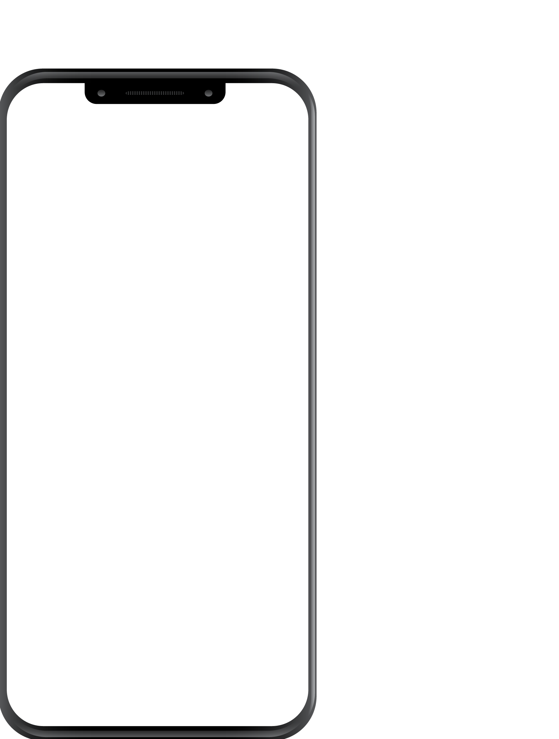
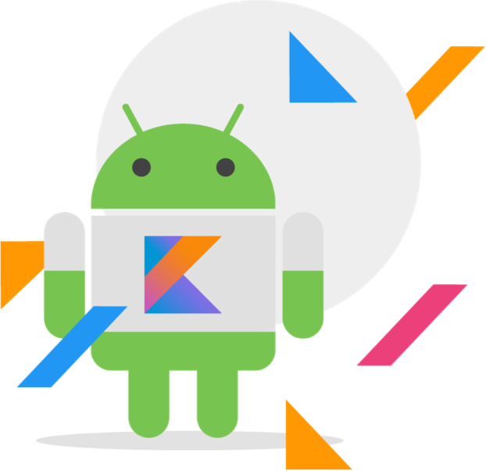

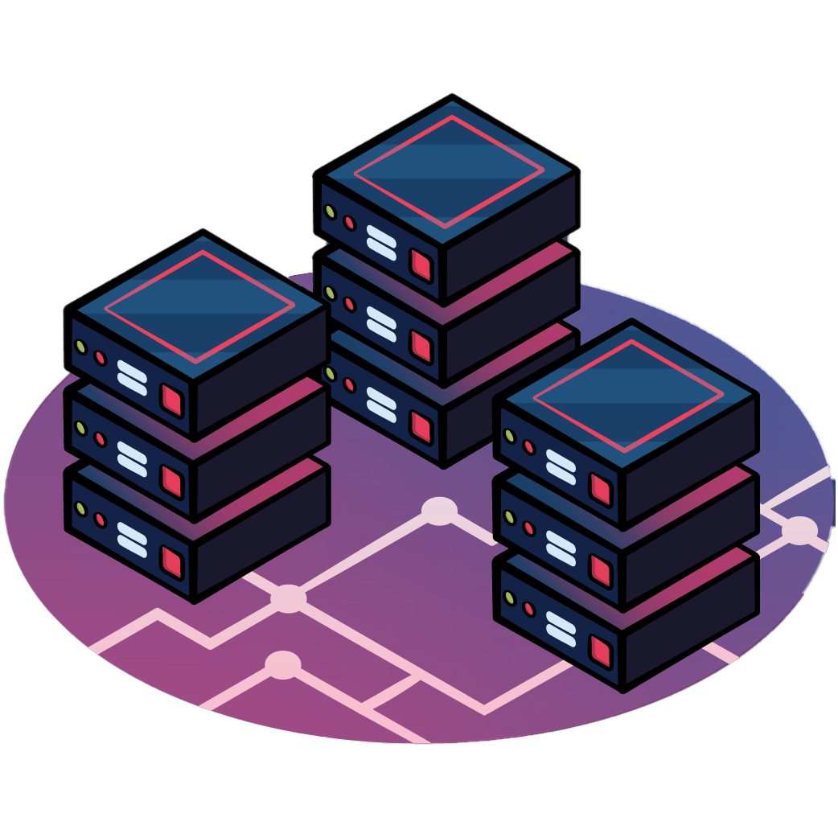
Back End Technology
Kotlin
Kotlin is a modern, trending programming language that was released in 2016 by JetBrains.
It has become very popular since it is compatible with Java, which means Java code can be used with Kotlin program
Kotlin is a cross-platform, statically typed, general-purpose programming language with type inference
Room Database
Apps that handle non-trivial amounts of structured data can benefit greatly from persisting that data locally.
The most common use case is to cache relevant pieces of data so that when the device cannot access the network, the user can still browse that content while they are offline.

Slide 10

Requirements
To run this app, minimum hardware and software requirement are listed below:
Hardware Requirements:
Device type: Smartphone or Tablet
Screen resolution: 800x480 pixels or higher
Free space: 100 MB of in the device's main memory
RAM: 2.00 GB
Processor: Snapdragon 636 or higher
Software Requirements:
Operating System: Android 7.0
Language used: Kotlin
Technologies: Android Development

Slide 11
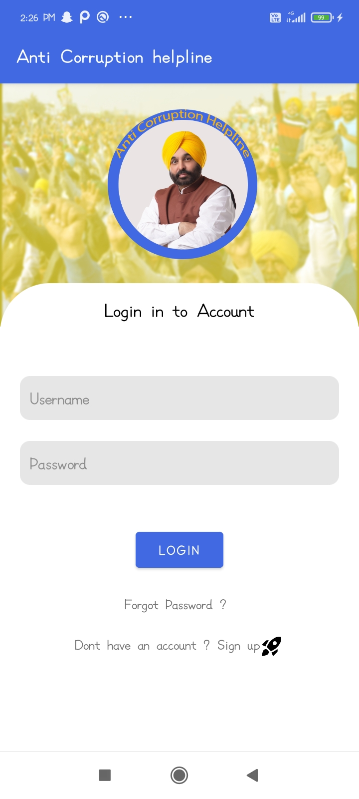
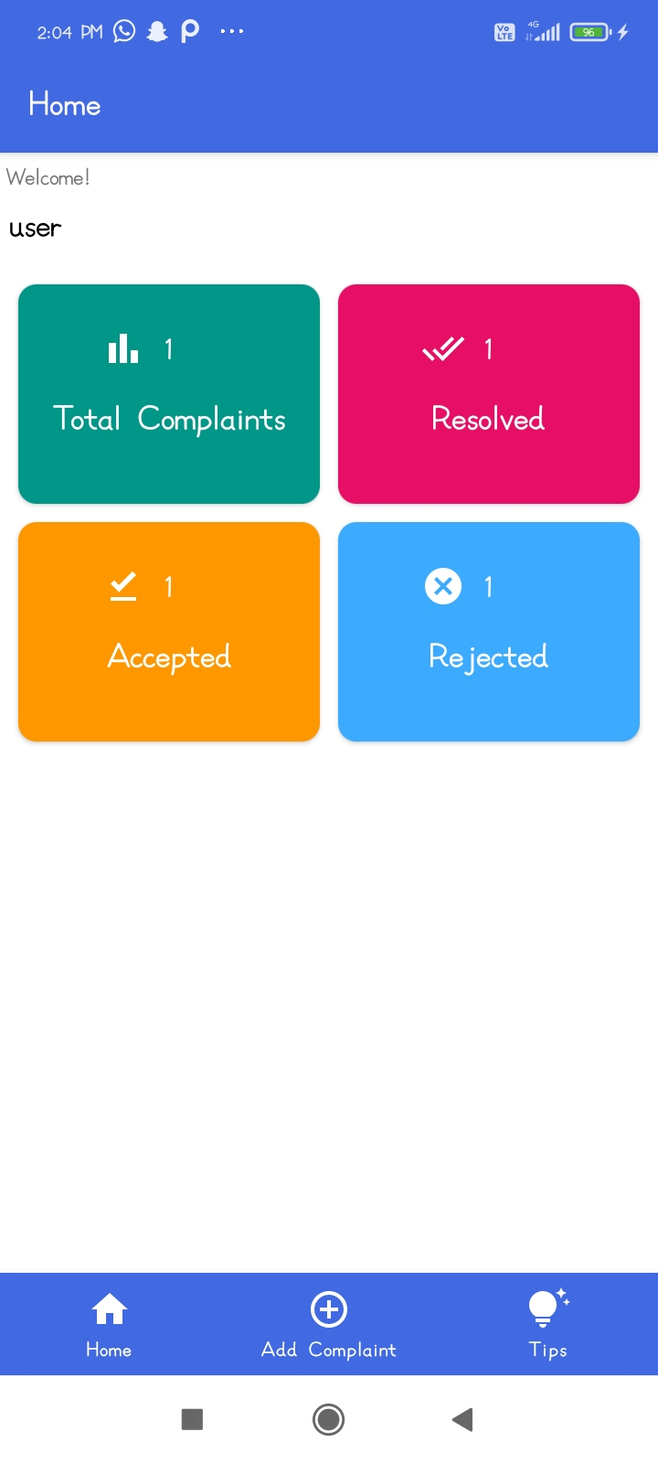
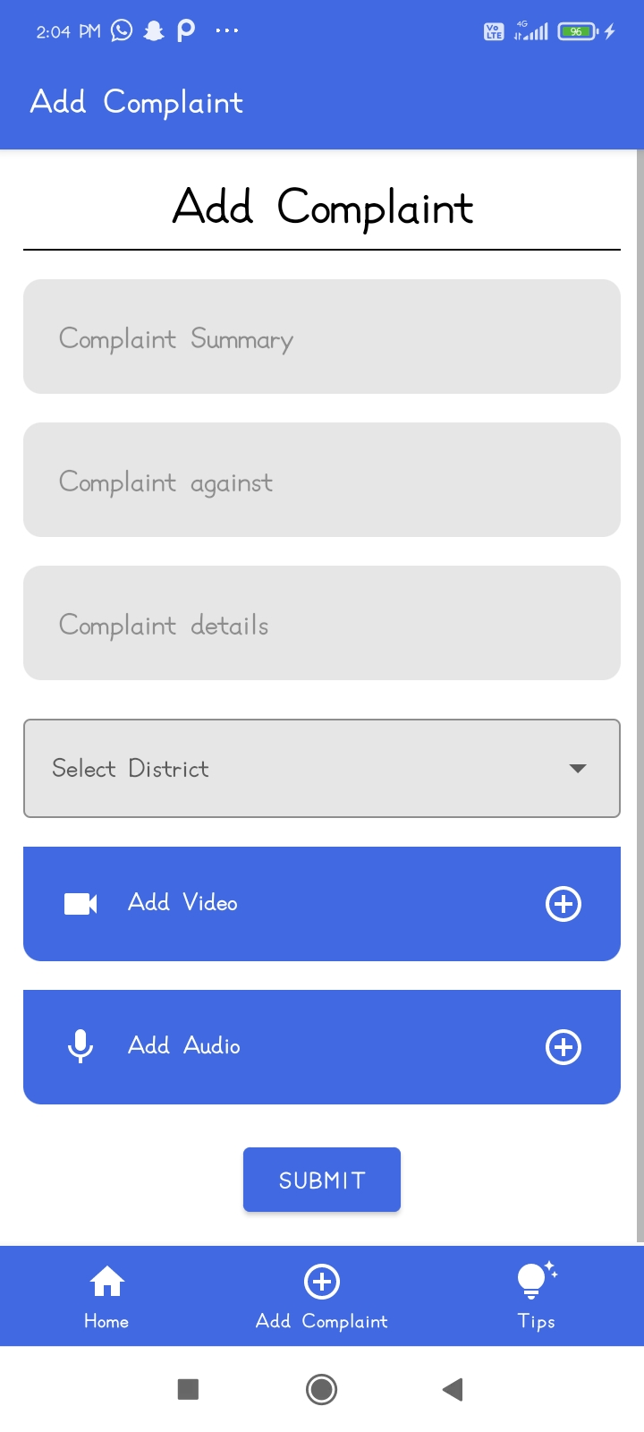
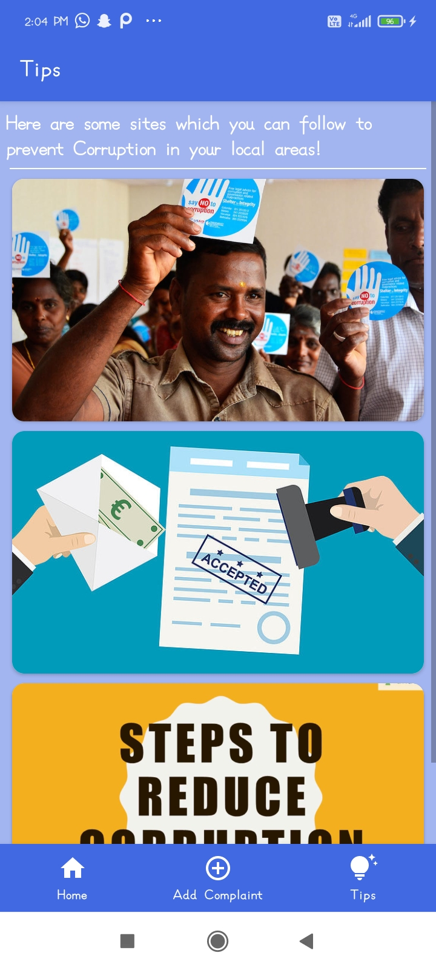
Screenshots

Slide 12


Conclusion
This is a very suitable application for the current situation of Punjab, where there are 63% people who paid bribe in the last 1 year.
This application will surely help in reducing the corruption rate and ensure smooth functioning of the system.
It will also help in lowering the violation of rules set by the government and along with protecting the rights of common people.

Slide 13

Future Work
In Upcoming Updates :
This application will be online, means users can login through their mobile
We can also register complaints about other crimes happening around us.
There will be a rule book attached to this application, which will contain rules against various crimes.

Slide 14


